Slide 1
Kaggle Presentations
AirBnB Price Prediction
By: Romauli Butarbutar

Slide 2
What I did right with the analysis
Part 1 - The steps of data analysis
Data Category for better understanding
Listing/URL, Host, Location, Property, Price, Term of condition, Additional descriptors **
Ignore insignificant variable: Null value, Id, Additional descriptor, Listing/URL descriptors **
Examine outliers by visualizing the data
Data Wrangling, Cleaning and Tidying
Reformat data, convert data type : date, character
Exclude data with country_code = ‘UY’ (for UK as most of the data for US)
Check blank data and impute missing value for both train and test
Word count for character data types e.g. summary, description
Check different types of amenities using Regular Expressions functions
Levelling multiple factoral variable and imputing the average price by group e.g. neighbourhood_group_cleansed
Notes:
In predicting the price of AirBnb, I explore the data first, skimming it and categorize the variable based on the state of having something in common, put it into 7 groups…..
Having a very basic view of the data, I found some of insignificant variable like….I mean It’s seem not affect the further analysis so I decided to ignore such kind of variables.
Then, I also visualizing the data using ggplot to find out the outliers of the price and compare it to the room_type, the outlier price in the range of $300 to $1000, and for the room type of entire home/apt have the highest price. It makes sense.
Before go further into modelling, I perform data wrangling, cleaning and tidying including….the most challenging part in data cleaning would be for the character data type which have longer text like…summary, description, and amenities. At the first try, I assume that kind of variables would have insignificant effect on modelling, but when I found my RMSE stuck at the same level, even after I perform several linear regression using many variables combinations, I realize I need to do something with such kind of variables.

Slide 3
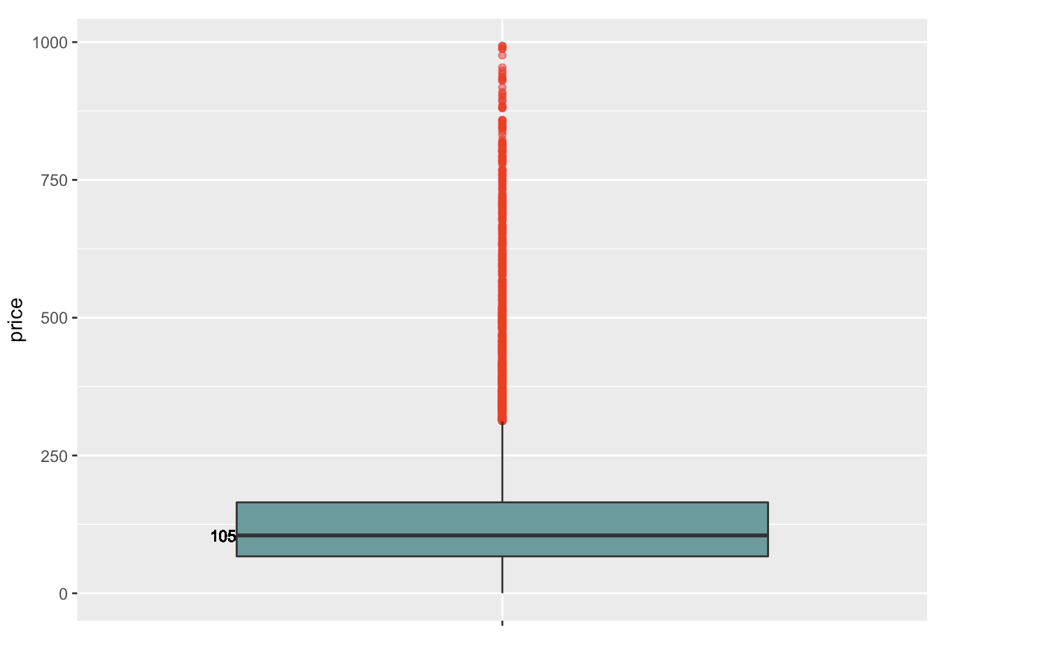
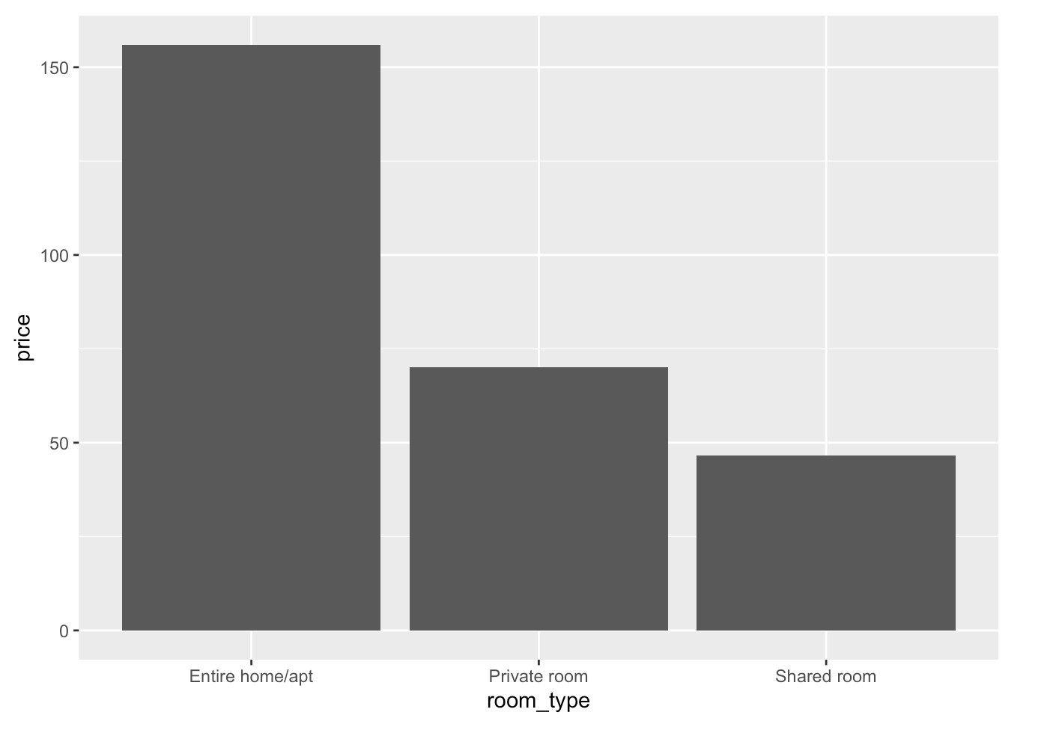
Examine outliers by visualizing the data

Slide 4
What I did wrong with the analysis
Part 2 – Creating The Models
Linear Regression per descriptor category, the least RSME is about 67.89162
Feature Selection :
**Corrplot, Best Subset Selection, Forward and Hybrid Selection, the least RSME is about 67.90036
**After perform shrinkage, the least RSME using Lasso method is about 68.38622,
Tree Model
**Simple Regression Tree, the least RSME is about 72.12098
**Regression Tree Complex, the least RSME is about 69.49447,
**Advanced Tree, the least RSME is about 51.00288 : but with note for file submission is not working (errors)
**Tree with Tuning, using 5-fold cross-validation. The least RSME is about 64.24447.
**When I try to perform Random Forest, Tuned Random Forest, Forest with Ranger and Boosting with cross-validation and Boosting with XGBoost it took so long time, so I decided to cut the process by terminating R.**
Final Boosting Models
After perform Data Cleaning Complexity, and include some wordcount and amenities, this is my FINAL MODEL with BOOSTING METHOD.
## predict train dataset : RMSE 37.50427
ON PUBLIC LEADERBOARD: 58.71
ON PRIVATE LEADERBOARD : 62.57
Model | RMSE
Linear Regression | 67.89162
Feature Selection - Corrplot, Best Subset Selection, Forward and Hybrid Selection - Lasso method | 67.90036 68.38622
Tree Model Simple Regression Tree Regression Tree Complex Advanced Tree Tree with Tuning, 5-fold cross-validation | 72.12098 69.49447 51.00288 64.24447
Final Boosting Method | 37.50427
ON PUBLIC LEADERBOARD | 58.71
ON PRIVATE LEADERBOARD | 62.57
Notes:
After the data preparation are all set, I start to creating the models. I try several models, range from Linear Regression, Tree Models, tuning it and Boosting Models.
I spend more time in doing linear regression for every aforementioned descriptor groups and pick the significant variable which have lower p value, but the least RMSE stuck at ….
Try to get less RMSE, I do several feature selections technic: ….unfortunately some of that shows higher RMSE.
Move into the next effort, I build Tree Model. For simple and tree complex regression the RMSE is not even better, just with Advanced Tree show a considerable change in RMSE value, at 51.00288. But it’s not working in creating file for submission as so many price unpredicted, null values in the output file. I do not want to give up I try to apply random forest, tuning it again, forest with ranger, and cross validation boosting and XGBoost.
Finally, I try to figure it out, I go back to perform more complicated data cleaning, using regular expression function in stringR, I analyze the amenities that put in the long character data type, separate it to every kind of amenities provided by the landlord like airconditioning, TV, internet, Wifi etc….include several of it into the modelling and get a very significant change in my last RMSE value ….. ## predict test dataset : RMSE 139.3448

Slide 5
Report Summarizing & Lesson Learned
The price of Airbnb rental affected by room type neighbourhood_group_cleansed, amenities, cleaning_fee,review, rating etc.
Before doing a deep analysis : the most significant independent variable mainly LOCATION
After modelling : detail description of apartment e.g summary, rating, neighborhood_overview etc
Suggestion : the detail description/ summary in the listing to gain more users and popularity.
The failed steps or missteps along the way
*So many errors for the first kick!
*Some of my models like XGBoosting Model, Tuning the Tree are not working and still confuse with the error.
*When I perform Dimension Reduction Technique, I found some errors that I decided to cut the process.
*Performing several technique of Forward selection and Hybrid selection would result insignificant difference, so I think we just need to choose one for time efficiency.
Notes:
To summarize, doing this project I get a better understanding of independent variables that related to the price. Before doing more effort data cleaning and deep dive in it, I assume that the most…..
After modelling, I found that review, rating, detail description on the listing website have a significant effect to gain more viewers and increase the popularity, that makes sense for this kind of business online.

Slide 6
“It is through science that we prove. But it is through intuition that we discover” — Henri Poincare —
More importantly, I realize that the level of complexity of the model and variables probably could lead to overfitting problem.
70% of the time is for data cleaning, wrangling and tidying
It is important to use the common knowledge and use a good intuition how to logically select the relevant variables for a model, like the quotes.

Slide 7
boostModelFinal = gbm(price ~ meanPrice+meanPriceGC + level_nc + bedrooms + room_type + property_type + bathrooms + beds
+ accommodates + cleaning_fee + monthly_price + security_deposit + minimum_nights + maximum_nights + neighbourhood_group_cleansed
+ host_is_superhost + availability_30 + availability_60 + availability_90 + availability_365
+ review_scores_rating + number_of_reviews + last_review_days + first_review_days + review_scores_cleanliness + review_scores_accuracy
+ wc_transit + wc_summary+ wc_description+ wc_host_about + wc_neighborhood_overview #word count
+ host_listings_count + host_since_days + reviews_per_month + host_has_profile_pic
+ extra_people + guests_included + cancellation_policy
+ Airconditioning + Dryer + Elevator + Familykidfriendly + Freestreetparking #amenities
+ Hairdryer + Iron + Oven + Refrigerator + Shampoo + Selfcheckin #amenities
,data = train, distribution = "gaussian",
n.trees = 30000,
interaction.depth = 5,
shrinkage = 0.005,
n.minobsinnode = 5)

